Slide 1
6. Memory Management
Course Exercise in Operating System
Email：wangfengyu@sdu.edu.cn
Notes:
更改记录：2010-11-16 格式

Slide 2
Outline
Why Memory Management
Address Binding
Logical and Physical Address Spaces
Contiguous Allocation
Paging
Nachos Memory Management
  Nachos User Programs and their Address Spaces
  Current Nachos Memory Management

Slide 3
Why Memory Management
In order to run a user process, the operating system needs to：
  allocate memory for the address space of the process, which consists of
    text
    initialized and uninitialized data
    stack for procedure calls and returns
    heap for dynamically allocated variables
  de-allocate the memory for the address space, when the user process is deleted.
  manage the entire physical memory for user processes so that processes can share it.

Slide 4
Why Memory Management
Requirements for Memory Management
  address binding - determining the physical address for each memory reference in the program
  sharing the physical memory between multiple user processes
  protection from illegal access
    preventing access from other processes
    preventing illegal operation from within the process
  efficient use of physical memory: minimizing memory fragmentation
  fast access: do not slow down the memory access

Slide 5
Outline
Why Memory Management
Address Binding
Logical and Physical Address Spaces
Contiguous Allocation
Paging
Segmentation
Paging with Segmentation
Nachos Memory Management
  Nachos User Programs and their Address Spaces
  Current Nachos Memory Management

Slide 6
Address Binding
From Programs to Executables in Memory
  programs to object modules: done by compiler
  object modules to the load module: done by linker
  the load module to the executable in memory: done by loader
Object Module
  header: sizes and offsets of all sections
  code: text of the program
  initialized data
  symbol table: external symbols
  … …
Notes:
目标文件中的符号表用来输出函数/变量符号信息，供连接时给其他模块引用。这种符号表中主要包含函数/变量的名称和地址对应关系 。
relocation information？

Slide 7
Address Binding
What is the load module we got?
  It includes all the object modules (text and data).
  All the external references are resolved.
  It has a single address space starting from zero.
Loading a load module
  copy the text and initialized data
  expand the uninitialized data section
  create a stack
  create a heap for dynamically allocated variables

Slide 8
Address Binding
Address Space Binding of Relocatable Load Mode
  static relocation
    done at load time
    address binding cannot change at run time
  dynamic relocation
    done at run time
    supported by Memory Management Unit (MMU)

Slide 9
Outline
Why Memory Management
Address Binding
Logical and Physical Address Spaces
Contiguous Allocation
Paging
Nachos Memory Management
  Nachos User Programs and their Address Spaces
  Current Nachos Memory Management

Slide 10
Logical and Physical Address Spaces
Logical Address and its Space
  addresses issued by the CPU
Physical Address and its Space
  addresses seen by the memory unit
  real addresses of the instructions and data

Slide 11
Logical and Physical Address Spaces
Logical Address = Physical Address, if
  static relocation is done at load time
Logical Address != Physical Address, if
  dynamic relocation is at rum time
  supported by relocation register
Memory Management Unit
  hardware device
  support mapping of logical to physical address space

Slide 12
Outline
Why Memory Management
Address Binding
Logical and Physical Address Spaces
Contiguous Allocation
Paging
Nachos Memory Management
  Nachos User Programs and their Address Spaces
  Current Nachos Memory Management

Slide 13
Contiguous Allocation
Classical Dynamic Storage Allocation Problem
  given
    single partition of storage space (memory)
    input queue of processes (job queue), each requiring a storage for its address space
    Free Storage Management
      list of free space of contiguous memory (holes)
  devise an algorithm to satisfy as many as jobs as possible

Slide 14
Contiguous Allocation
Data Structure
  List of holes (free space management)
  Input job queues
Basic algorithm
  Find a hole to match a job from the input queue
  Split the hole and return the unused (smaller) hole back to the list
  Merge the adjacent holes when the job is completed
Problem
  fragmentation and compaction
Notes:
连续分配方式会形成许多“碎片”，虽然可以通过“紧凑”方法将碎片拼接成可用的大块空间，但须为此付出很大开销。如果允许将一个进程直接分散地分配到不相邻的分区中，就不必再进行“紧凑”，基于这一思想而产生了离散分配方式。

Slide 15
Outline
Why Memory Management
Address Binding
Logical and Physical Address Spaces
Contiguous Allocation
Paging
Nachos Memory Management
  Nachos User Programs and their Address Spaces
  Current Nachos Memory Management

Slide 16
Paging
What is Paging?
  Another way of mapping of logical address to physical address
    to eliminate external fragmentation and compaction
Mechanism
  Frames: fixed-size blocks of physical address space, normally in powers of two
  Pages: fixed-size blocks of the same size in logical address space
  page table: mapping pages to frames
Non-contiguous mapping
  The page frames of an address space do not have to be contiguous.
  Needs fast address translation (page table can be large and needs to be in memory)

Slide 17
Paging
Physical Address Space
  address space size: 2^{k} bytes
  page frame size: 2^{n} bytes (n < k)
  turning linear address, a, into a pair (f, d):
    f: frame number
    d: displacement
    f = a div 2^{n} (k - n bits)
    d = a mod 2^{n} (n bits)

Slide 18
Paging
Logical Address Space
  address space size: 2^{m} bytes
  page size: 2^{n} bytes (n < m)
  turning linear address, l, into a pair (p, d):
    p: page number
    d: displacement
    p = l div 2^{n} (m - n bits)
    d = l mod 2^{n} (n bits)
Page Table
  mapping page number p to frame number f

Slide 19
Paging
Implementation of Paging
  extract p from logical address l
  extract d from logical address l
  map p to f using page table
  assemble physical address a using (f, d)

Slide 20
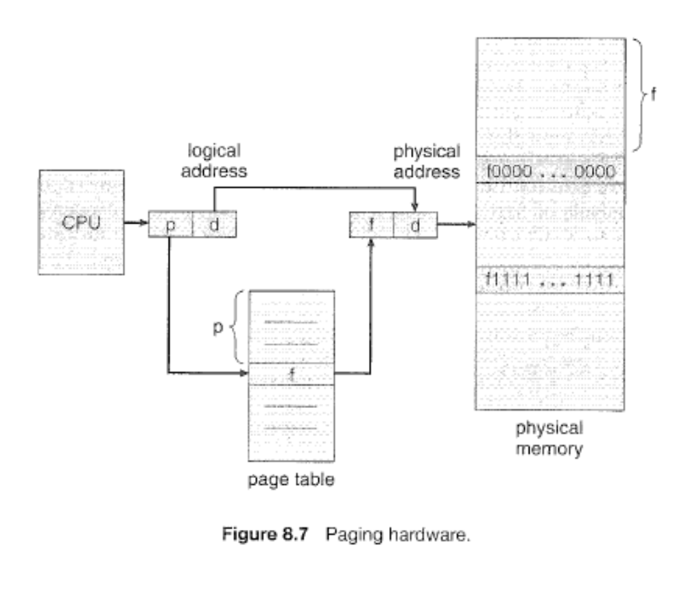
Paging

Slide 21
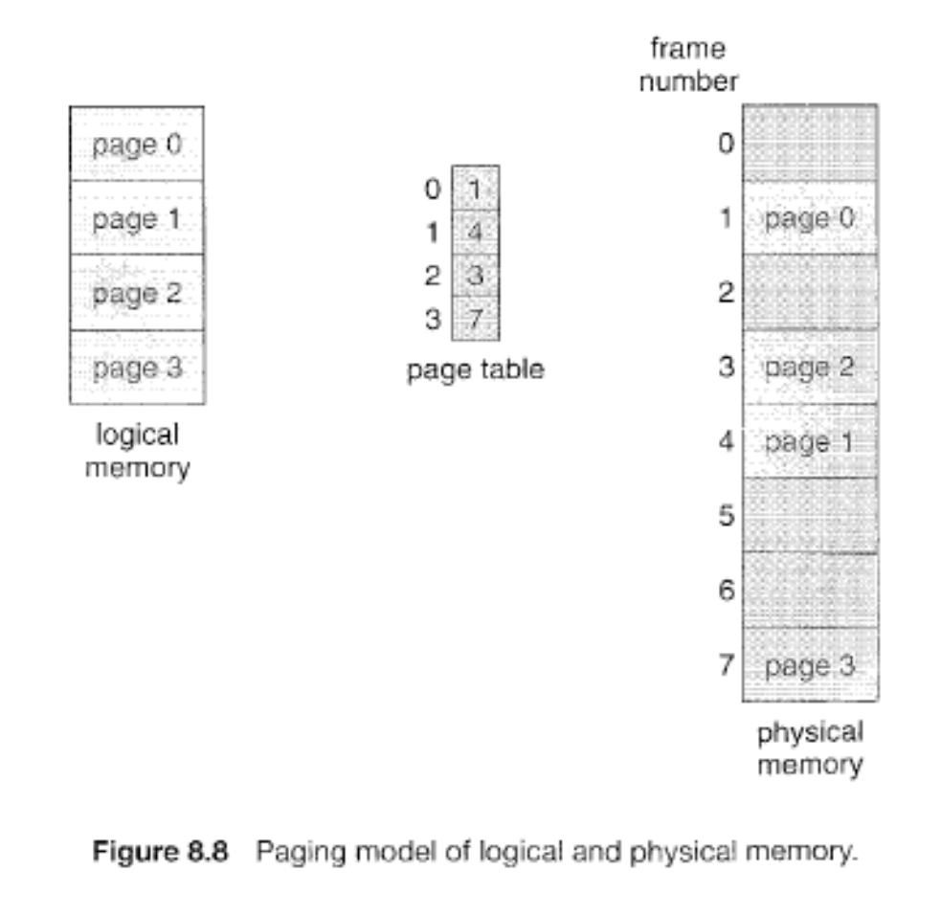
Paging

Slide 22
Paging
User Process Page Tables
  each user process has a page table
  need to be saved and restored during the context switch

Slide 23
Paging
Problems with Paging
  two memory accesses for each logical address
    page table access
    physical address access
Hardware Support with TLB
  Translation Look-aside Buffer (TLB)
    fast associate memory (registers)
    addressed by contents
    entry: pair (p, f )
Notes:
TLB 后备转换缓冲器

Slide 24
Paging
  caching translation
    store recent translations
    TLB hit: translation for p exists in TLB
    TLB miss: translation for p does not exits in TLB and store the translation
    If TLB is full when a TLB miss occurs, replace one of the entries with the new translation.
  effective memory access time
    ea = H (ta + ma) + (1- H) *(ta + 2 *ma)
    H: TLB hit ratio
    ta: TLB table look up time
    ma: memory access time
Notes:
2* ma ------page table entry + desired data in memory?

Slide 25
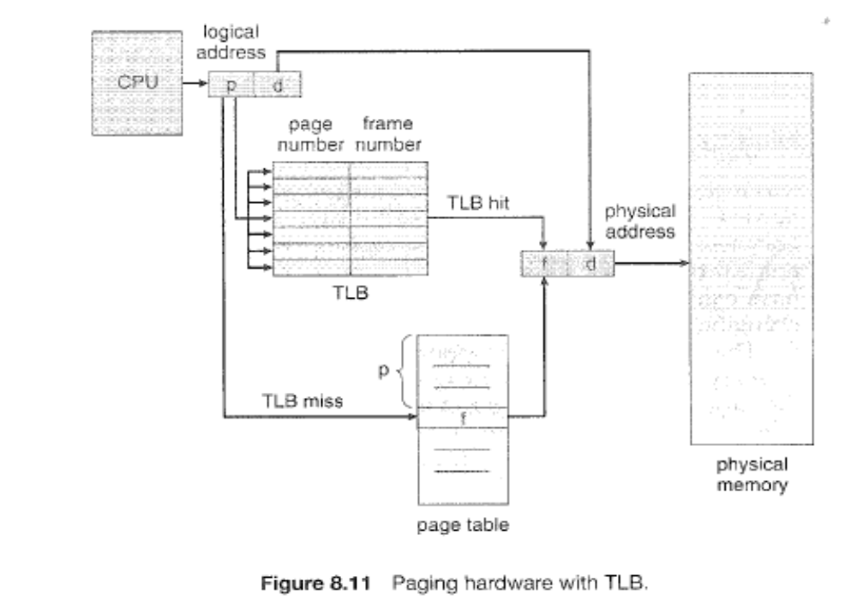
Paging

Slide 26
Outline
Why Memory Management
Address Binding
Logical and Physical Address Spaces
Contiguous Allocation
Paging
Nachos Memory Management
  Nachos User Programs and their Address Spaces
  Current Nachos Memory Management

Slide 27
Nachos User Programs and their Address Spaces
User Programs of Nachos
  Nachos uses a MIPS simulator to run user programs
  The gcc MIPS cross-compiler is used to translate user programs to load modules for MIPS.
Procedure to Make Nachos User Programs
  Compile user programs in C to object modules for MIPS
  Compile the start program start.s into the object module for MIPS
  Link the object modules to the load module using UNIX COFF format
  Convert the load module to use the Nachos executable format -NOFF
Notes:
此处未详细介绍machine的实现，放在下一课

Slide 28
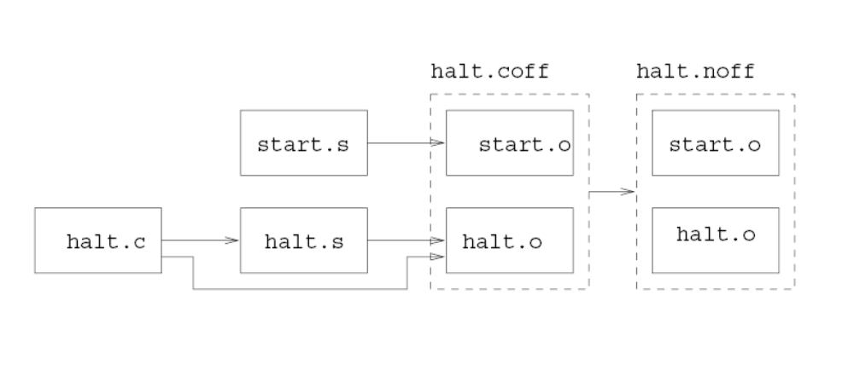
Nachos User Programs and their Address Spaces

Slide 29
Nachos User Programs and their Address Spaces
Nachos NOFF format (../bin/noff.h)
  #define NOFFMAGIC 0xbadfad /* magic number denoting Nachos
  * object code file
  */
  typedef struct segment {
    int virtualAddr; /* location of segment in virt addr space */
    int inFileAddr; /* location of segment in this file */
    int size; /* size of segment */
  } Segment;
  typedef struct noffHeader {
    int noffMagic; /* should be NOFFMAGIC */
    Segment code; /* executable code segment */
    Segment initData; /* initialized data segment */
    Segment uninitData; /* uninitialized data segment --
    * should be zero'ed before use
    */
  } NoffHeader;

Slide 30
Nachos User Programs and their Address Spaces
From Nachos Threads to Nachos User Processes
  A Nachos user process is a Nachos thread with
    user address space
    user-level register state
  Additional definitions in Thread.h
    #ifdef USER_PROGRAM
    // A thread running a user program actually has *two* sets of CPU registers --
    // one for its state while executing user code, one for its state
    // while executing kernel code.
    int userRegisters[NumTotalRegs]; // user-level CPU register state
    public:
      void SaveUserState(); // save user-level register state
      void RestoreUserState(); // restore user-level register state
      AddrSpace *space; // User code this thread is running.
    #endif

Slide 31
Nachos User Programs and their Address Spaces
The actual address of the user process has to be constructed before the user process can run
  void StartProcess(char *filename)
  {
    OpenFile *executable = fileSystem->Open(filename);
    AddrSpace *space;
    if (executable == NULL) {
      printf("Unable to open file %s\n", filename);
      return;
    }
    space = new AddrSpace(executable);
    currentThread->space = space;
    delete executable; // close file
    space->InitRegisters(); // set the initial register values
    space->RestoreState(); // load page table register
    machine->Run(); // jump to the user progam
    ASSERT(FALSE); // machine->Run never returns;
    // the address space exits by doing the syscall "exit"
  }

Slide 32
Nachos User Programs and their Address Spaces
MIPS Simulator in Nachos
  The execution of Nachos user programs is simulated on a MIPS simulator.
  The MIPS machine simulated has the following components:
    User Registers: the registers used by user programs
    Main Memory: the physical memory of the machine for all user programs
    TLB: a Table Look ahead Buffer
    Page Table: a pointer to the current page table
    char *mainMemory; // physical memory to store user program,
    // code and data, while executing
    int registers[NumTotalRegs];
    TranslationEntry *tlb; // this pointer should be considered
    // "read-only" to Nachos kernel code
    TranslationEntry *pageTable;

Slide 33
Nachos User Programs and their Address Spaces
Page Table and Address Space of Nachos User Process
  Page table and TLB share the same structure for table entries
  class TranslationEntry {
  public:
    int virtualPage; // The page number in virtual memory.
    int physicalPage; // The page number in real memory (relative to the
    // start of "mainMemory"
    bool valid; // If this bit is set, the translation is ignored.
    // (In other words, the entry hasn't been initialized.)
    bool readOnly; // If this bit is set, the user program is not allowed
    // to modify the contents of the page.
    bool use; // This bit is set by the hardware every time the
    // page is referenced or modified.
    bool dirty; // This bit is set by the hardware every time the
    // page is modified.
  };

Slide 34
Nachos User Programs and their Address Spaces
Address Space Class AddrSpace
  contains the page table of the user process
    class AddrSpace {
    public:
    ...
    private:
      TranslationEntry *pageTable; // Assume linear page table
      // translation for now!
      unsigned int numPages; // Number of pages in the virtual
      // address space
    };

Slide 35
Nachos User Programs and their Address Spaces
How is the program loaded into memory to form the address space?
    AddrSpace::AddrSpace(OpenFile *executable)
    {
      NoffHeader noffH;
      unsigned int i, size;
      executable->ReadAt((char *)&noffH, sizeof(noffH), 0);
      if ((noffH.noffMagic != NOFFMAGIC) &&
      (WordToHost(noffH.noffMagic) ==NOFFMAGIC))
      SwapHeader(&noffH);
      ASSERT(noffH.noffMagic == NOFFMAGIC);
      // how big is address space?
      size = noffH.code.size + noffH.initData.size + noffH.uninitData.size
      + UserStackSize; // we need to increase the size
      // to leave room for the stack
      numPages = divRoundUp(size, PageSize);
      size = numPages * PageSize;

Slide 36
Nachos User Programs and their Address Spaces
    ASSERT(numPages <= NumPhysPages); // check we're not trying to run
    // anything too big --at least until
    //we have virtual memory
    DEBUG('a', "Initializing address space, num pages %d, size %d\n", numPages, size);
    // first, set up the translation
    pageTable = new TranslationEntry[numPages];
    for (i = 0; i < numPages; i++) {
      pageTable[i].virtualPage = i; // for now, virtual page # = phys page #
      pageTable[i].physicalPage = i;
      pageTable[i].valid = TRUE;
      pageTable[i].use = FALSE;
      pageTable[i].dirty = FALSE;
      pageTable[i].readOnly = FALSE; // if the code segment was entirely on
    // a separate page, we could set its
    // pages to be read-only
    }
    // zero out the entire address space, to zero the uninitialized data segment
    // and the stack segment
    bzero(machine->mainMemory, size);

Slide 37
Nachos User Programs and their Address Spaces
    // then, copy in the code and data segments into memory
    if (noffH.code.size > 0) {
      DEBUG('a', "Initializing code segment, at 0x%x, size %d\n",
      noffH.code.virtualAddr, noffH.code.size);
      executable->ReadAt(&(machine->mainMemory[noffH.code.virtualAddr]),
      noffH.code.size, noffH.code.inFileAddr);
    }
    if (noffH.initData.size > 0) {
      DEBUG('a', "Initializing data segment, at 0x%x, size %d\n",
      noffH.initData.virtualAddr, noffH.initData.size);
      executable->ReadAt(&(machine->mainMemory[noffH.initData.virtualAddr]),
      noffH.initData.size, noffH.initData.inFileAddr);
    }
  }

Slide 38
Outline
Why Memory Management
Address Binding
Logical and Physical Address Spaces
Contiguous Allocation
Paging
Segmentation
Paging with Segmentation
Nachos Memory Management
  Nachos User Programs and their Address Spaces
  Current Nachos Memory Management

Slide 39
Current Nachos Memory Management
Current Nachos
  always maps frame i to page i
  cannot load more than one user process
  does not use free storage management
  is not truly multiprogramming yet

Slide 40
Current Nachos Memory Management
Memory accesses simulated by functions
  Machine::ReadMem(int addr, int size, int *value)
  Machine::WriteMem(int addr, int size, int value)
  addr -logical address issued by CPU
The Nachos memory management uses paging with TLB.
Support by the Memory Management Unit (MMU) simulated by function
Machine::Translate(int virtAddr,int* physAddr,int size, bool writing)

Slide 41
Current Nachos Memory Management
ExceptionType
Machine::Translate(int virtAddr, int* physAddr, int size, bool writing)
{
  int i;
  unsigned int vpn, offset;
  TranslationEntry *entry;
  unsigned int pageFrame;
  DEBUG('a', "\tTranslate 0x%x, %s: ", virtAddr, writing ? "write" : "read");
  // check for alignment errors
  ...
  // we must have either a TLB or a page table, but not both!
  ...

Slide 42
Current Nachos Memory Management
  // calculate the virtual page number, and offset within the page,
  // from the virtual address
  vpn = (unsigned) virtAddr / PageSize;
  offset = (unsigned) virtAddr % PageSize;
  if (tlb == NULL) { // => page table => vpn is index into table
  if (vpn >= pageTableSize) {
  DEBUG('a', "virtual page # %d too large for page table size %d!\n",
  virtAddr, pageTableSize);
  return AddressErrorException;
  }
  else if (!pageTable[vpn].valid) {
  DEBUG('a', "virtual page # %d too large for page table size %d!\n",
virtAddr, pageTableSize);
return PageFaultException;
}
entry = &pageTable[vpn];

Slide 43
Current Nachos Memory Management
  }
  else {
    for (entry = NULL, i = 0; i < TLBSize; i++)
    if (tlb[i].valid && ((unsigned int)tlb[i].virtualPage == vpn)) {
    entry = &tlb[i]; // FOUND!
    break;
    }
    if (entry == NULL) { // not found
    DEBUG('a', "*** no valid TLB entry found for this virtual page!\n");
    return PageFaultException; // really, this is a TLB fault,
    // the page may be in memory,
    // but not in the TLB
    }
  }

Slide 44
Current Nachos Memory Management
  if (entry->readOnly && writing) { // trying to write to a read-only page
    DEBUG('a', "%d mapped read-only at %d in TLB!\n", virtAddr, i);
    return ReadOnlyException;
  }
  pageFrame = entry->physicalPage;
  // if the pageFrame is too big, there is something really wrong!
  // An invalid translation was loaded into the page table or TLB.
  if (pageFrame >= NumPhysPages) {
    DEBUG('a', "*** frame %d > %d!\n", pageFrame, NumPhysPages);
    return BusErrorException;
  }
  entry->use = TRUE; // set the use, dirty bits
  if (writing)
  entry->dirty = TRUE;
  *physAddr = pageFrame * PageSize + offset;
  ASSERT((*physAddr >= 0) && ((*physAddr + size) <= MemorySize));
  DEBUG('a', "phys addr = 0x%x\n", *physAddr);
  return NoException;
}

Slide 45
Laboratory
Lab 6：Nachos User Program and System Calls

